Slide 1
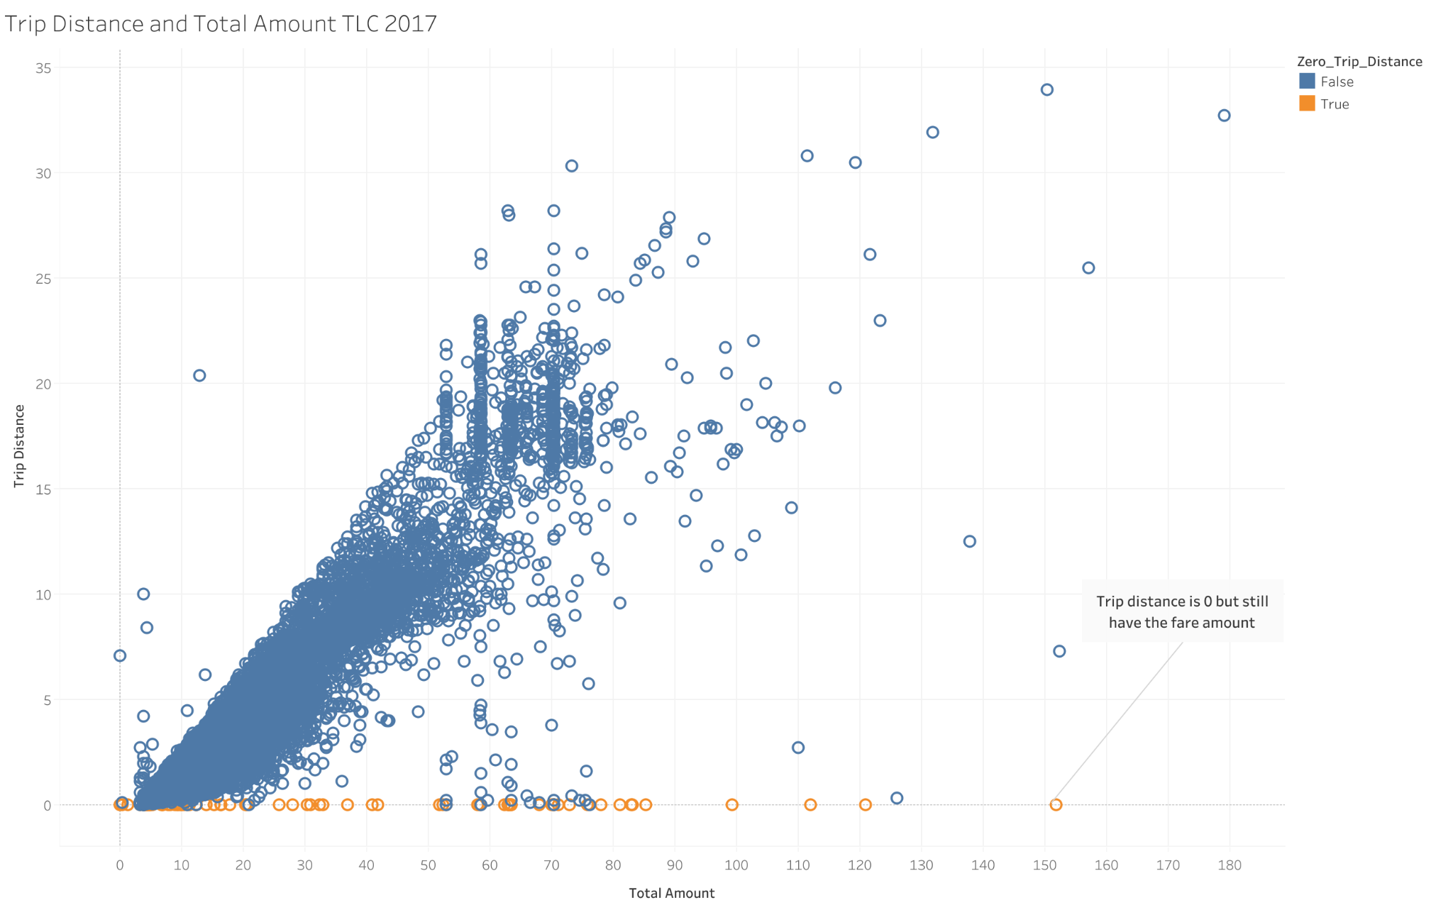
Exploratory Data Analysis of New York City TLC Data
Executive Summary Report by Automatidata
Project Overview
The NYC Taxi & Limousine Commission has contracted with Automatidata to build a regression model that predicts taxi cab ride fares. In this part of the project, the data needs to be analyzed, explored, cleaned and structured prior to any modeling.
The Problem: After running the Exploratory Data Analysis of New York City TLC Data, it clear that some data are prone to be obstacle for accurate ride fare prediction. Eventhough trips have the amount, the distance is only “0”. Therefore, these anomalies or outliers need to be factored into the algorithm or removed completely.
Proposed Solution: We recommend to remove the outliers with the distance data of “0”.
Key to Success:
Ensuring with the stakeholders that the sample data provided is accurate.
Plan for handling the other outliers, such as low trips
NYC TLC data plotting variables for Total Distance and Total Amount
As a result of EDA by Automatidata data team, trip distance and total amount could be considered as key variables to depict the taxi fares. The scatter plot shows the relationships of these two variables.
Determine the any usual data point that could pose a problem for future analysis in the taxi fares prediction.
Determine the variables that have impact on the taxi fare prediction.
Consider the most relevant variables for the running regression and statistical analysis.

